Slide 1

Location-Based Ad-Platform: Driving Consumer Engagement and Attribution Demo Project on Retail Boost Case Study
Tünde Szabó, PhD
Product Owner/Manager

Slide 2

Description of My Research
Develop a location-based ad-platform to give brands actionable insights into audience behaviour origins, daily mobility, and space utilization
Identifying core user needs beyond stated desires,
Using a hypothesis-driven, observational approach to validate these needs and identify critical product features
Notes:
The objective of creating a location-integrated ad-platform to bridge the gap between digital and physical consumer behaviors.
Describe the research focus on validating user needs, emphasizing how observing user behavior in real-world contexts (rather than relying solely on feedback) provides insights into true product value.

Slide 3

Market analysis
Need
Uniqueness
Positioning
Few ad platforms provide comprehensive location-based insights combined with real-time attribution and in-flight adjustments
Integration of real-time consumer behavior insights and location-based analytics, providing advertisers with precise, actionable data
Premium, data-centric ad solution in the digital marketing space for brands aiming to optimize physical engagement and in-store traffic

Slide 4
Viability
TAM $50 billion
SAM $15 billion
SOM $500 million
Digital advertising platforms with location-based services
Markets specifically leveraging real-time consumer behaviour analytics
Targeted growth rate of 20% annually, achievable by capturing high-value clients in retail and digital marketing

Slide 5



Customers
$300M
Large retail chains
Foot traffic through targeted, location-based ads
$120M
Digital Marketing Agencies
High-performing ad solutions with measurable real-world impact
$80M
Real Estate Developers
Foot traffic analytics for strategic location planning

Slide 6



COSTS
Development
$1.5 million
Operation
$500,000
Marketing and Sales
$300,000
over two years, including software development, data processing capabilities, and cloud infrastructure
annually, including customer support, data privacy compliance, and cloud storage
annually, ppromotional campaigns, B2B marketing, and sales outreach for client acquisition

Slide 7

My Approach
Identifying User Needs
Costumers want to increase conversion rate by 15% by applying integrated location data
Method Used
User Interviews conducted with InMarket and W.UP (2021-22)
Hypothesis Testing
A/B Testing and Problem-Solution Validation
Data-Driven Decision
>15%: proceed with scaling the approach across campaigns
<15%: analyse which variables (e.g., location, ad type) had the most significant impact.
Notes:
Hypothesis-Driven Validation
Hypothesis: location describes lifestyle which enables ads to be targeted more precisely, and thus, leads to higher conversion.
The product needed to be designed based on what customers express but also to reveal deeper motivations and challenges. Hypothesis testing allows us to uncover these root needs and adapt our product strategy accordingly.
Hypothesis Testing
The objective is to validate whether integrating location data can indeed lead to a 15% increase in conversion rates.
Approach
A/B Testing: Run A/B tests by dividing the audience into two groups:
Group A: Exposed to ads with integrated location data targeting.
Group B: Exposed to regular ads without location data.
Measure the conversion rate for each group over a set period.
Success Metric: If Group A shows at least a 15% increase in conversion rate compared to Group B, the hypothesis is supported
Problem-Solution Validation
The objective is to test if integrating location data is the right solution to achieve the desired 15% increase in conversion rates.
Method
Implement a pilot campaign for a select group of customers, integrating location data and monitoring the results closely.
Gather feedback from these customers to assess if the expected conversion rate increase meets their expectations.
Data Collection - assure pilot campaign metrics and customer feedback to validate that location data integration addresses the problem effectively
Data-Driven Decision
Focus resources on areas that showed the highest return and explore further optimizations or additional features (e.g., real-time attribution) to enhance the platform’s effectiveness

Slide 8

Retail Boost Case Study Driving Foot Traffic and Sales with Location-Based Campaigns

Slide 9

Case Study Overview
Objective
User Definition
Demonstrate how a retail brand uses location-based ads to drive visits and sales
'CompanyX,' a retail brand specializing in sustainable fashion
Target Audience
Goals
Environmentally conscious consumers aged 25-45
Increase foot traffic by 20%
Boost in-store sales by 15%

Slide 10

Case Study Overview
Objective
User Definition
Demonstrate how a retail brand uses location-based ads to drive visits and sales
'CompanyX,' a retail brand specializing in sustainable fashion
Target Audience
Goals
Environmentally conscious consumers aged 25-45
Increase foot traffic by 20%
Boost in-store sales by 15%

Slide 11
User journeys
1
Registration and Campaign Setup
Registration
Defining Campaign Goals
2
Campaign Creation
GeoFence Creation
GeoRetargeting Setup
3
Execution and
Real-Time Optimization
LCI Attribution Tracking
In-Flight Adjustments
4
Results and Reporting
Reviewing Impact Metrics
Downloading Reports

Slide 12
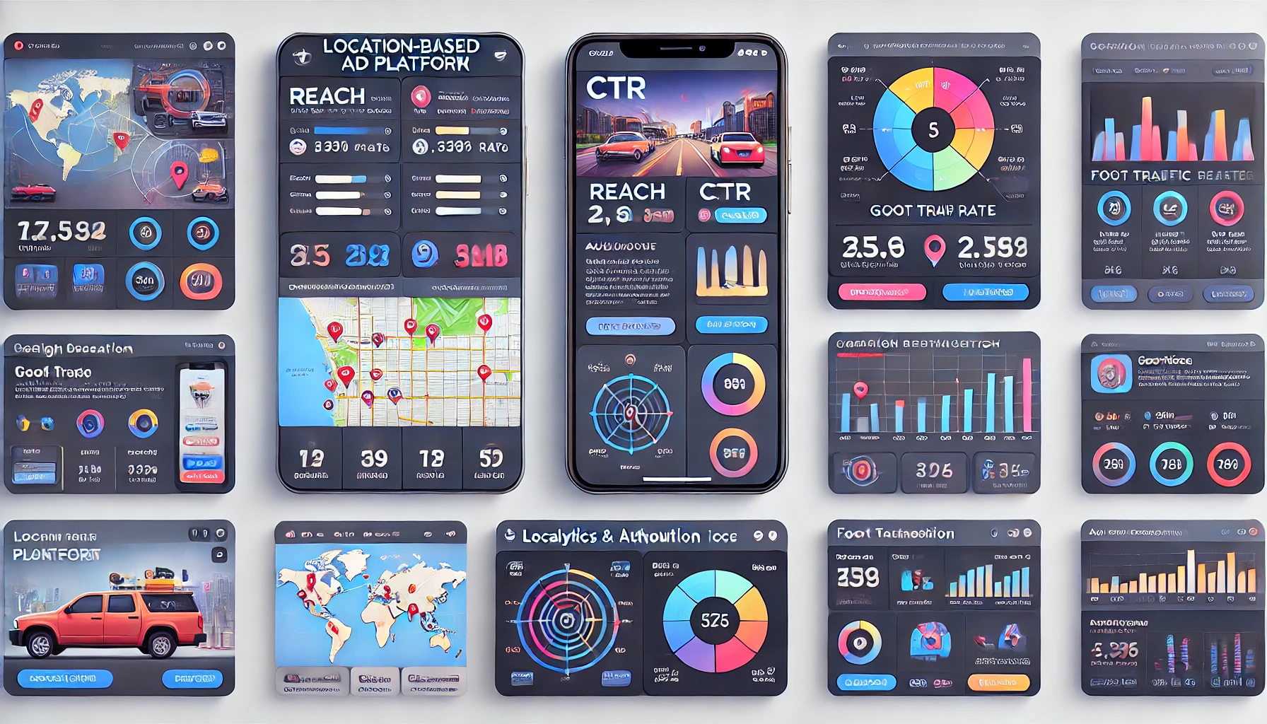
Wireframes
1. Dashboard Overview
Displays Reach, CTR, foot traffic, and real-time attribution data
2. Campaign Creation Interface
GeoFence and GeoRetargeting options with Location Score
3. Analytics and Attribution Dashboard
In-flight adjustments based on audience, channel, and creative insights

Slide 13
Feature Table
Feature | Description | User Benefits | Example
Registration & Onboarding | Guided registration process with onboarding walkthroughs | Quick start with minimal setup time; Familiarization with key features | Emma completes setup quickly, getting a tutorial on GeoFencing
Goal Specification | Options to define campaign goals, such as foot traffic increase, brand awareness, or sales boosts | Targeted campaigns aligned with marketing objectives | Emma sets her goal to increase foot traffic by 15%
GeoFence Targeting | Interactive map to define GeoFence zones around specific locations | Precise location-based targeting for relevant audiences | Emma creates a 5-mile GeoFence around CompanyX stores
GeoRetargeting | Re-engages users who have previously visited specific locations, with customizable messages | Improved conversion rates from repeat visitors | Emma targets past visitors with a discount on eco-products
Real-Time LCI Attribution | Lift Conversion Index tool that tracks conversion rates and foot traffic in real time | Immediate insights into campaign impact | Emma monitors foot traffic from the GeoFence area in real time
In-Flight Optimization | Allows live adjustments to campaign budgets, targeting zones, and ad content based on data insights | Increased efficiency by optimizing ad spend based on real-time performance | Emma reallocates budget to high-performing areas
Performance Dashboard | Visual dashboard that summarizes key metrics like CTR, ROAS, foot traffic increase, etc. | Quick overview of campaign effectiveness. | Emma sees a 20% increase in foot traffic from her campaign.
Detailed Reporting | Provides downloadable reports with customizable metrics and data views. | In-depth analysis for future campaign planning. | Emma downloads a detailed report for team review.
Customer Support & Guidance | Dedicated support for setup and troubleshooting, with tutorials on advanced features. | Enhanced user experience with reliable support. | Emma contacts support to learn more about GeoRetargeting.

Slide 14
Development Plan
Wireframes and campaign creation interfaces Architecture
Market analysis and user needs assessment
Research and Ideation
Design and Prototyping
Component Testing
2025
JAN
FEB
MAR
APR
MAY
JUN
JUL
AUG
SEP
OCT
NOV
DEC
2026
JAN
FEB
MAR
APR
MAY
JUN
JUL
AUG
SEP
OCT
NOV
DEC
Deployment
Testing and Iteration
Launch and Onboarding
Backend integration for real-time data processing
A/B testing with performance analysis
Training on attribution and optimization

Slide 15
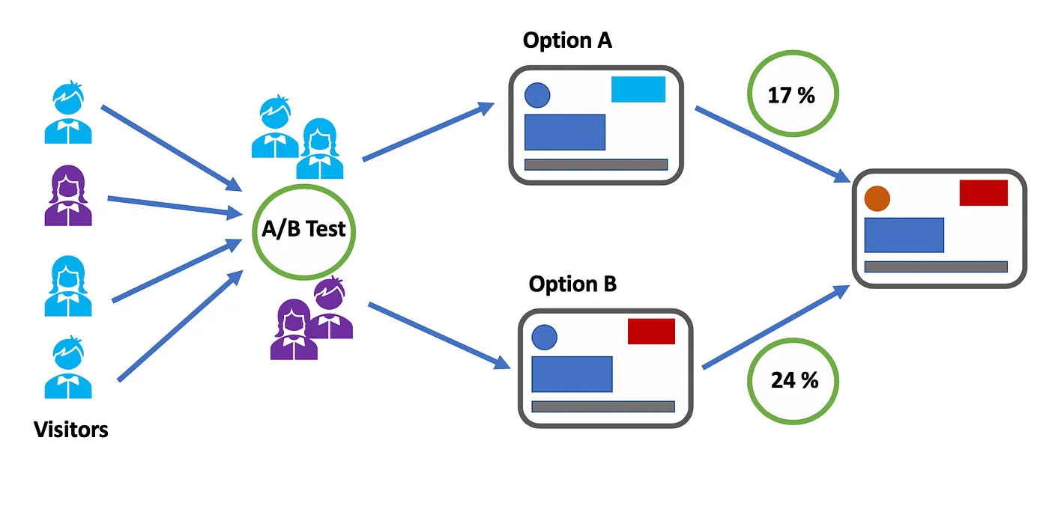
A/B Tests
4. Implement and Refine Based on Feedback
3. Evaluate Feedback
If a design yields higher CTR and retention rates, consider adopting it as the primary design
Establish a design framework based on successful elements from the tests
2. Conduct A/B Testing Sessions
1. Define Test Variants
Post-test survey to get qualitative feedback , asking about data clarity and perceived accuracy
A/B - List view/heatmap
User comments on visual appeal, data accessibility, and perceived accuracy

Slide 16
Results and Insights
30%
Increase in visits within
GeoFence areas
Foot Traffic
25%
Boost in repeat visitors
after retargeting
Repeat Visits
$40
Increase in return on ad spend
ROAS

Slide 17

Summary
The demo product development process used a user-centered approach, emphasizing hypothesis testing, A/B testing for UI optimization, and iterative feedback loops to create an engaging, data-driven ad-platform

Slide 18

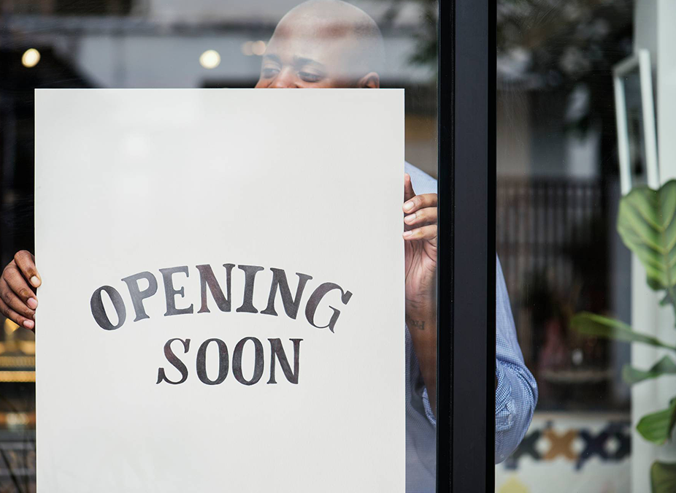
Thank you
Tünde Szabó PhD​
+36 70 611 2968
szabo.tunde@geoinsight.hu
www.geosinight.hu

